Slide 1


Group 5

Slide 2
What is Go Nuts?
A competitive networked multiplayer racing game
3-5 players
Simultaneous, symmetric gameplay
PC standalone
Keyboard & Mouse
Approx. 6 minutes of desired playtime per round

Slide 3
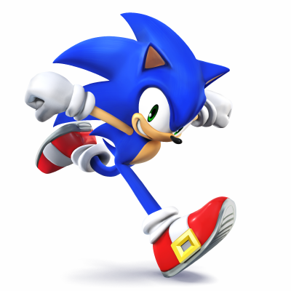
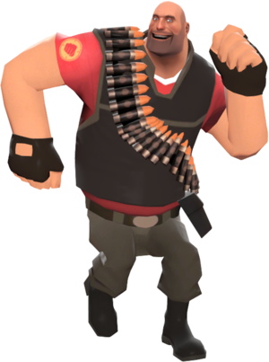
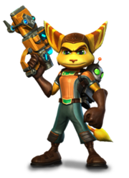
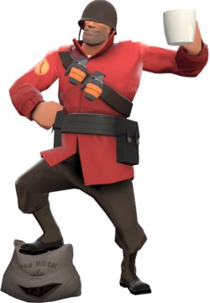
Who is it for?
Males aged 10-15
Fans of mascot-driven games (e.g. Ratchet and Clank, Sonic etc.).
Interested in multiplayer competitive skill-based games (TF2).

Slide 4
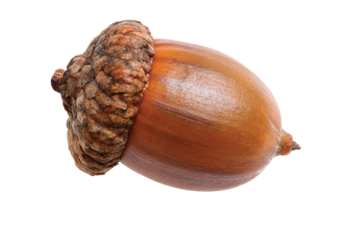
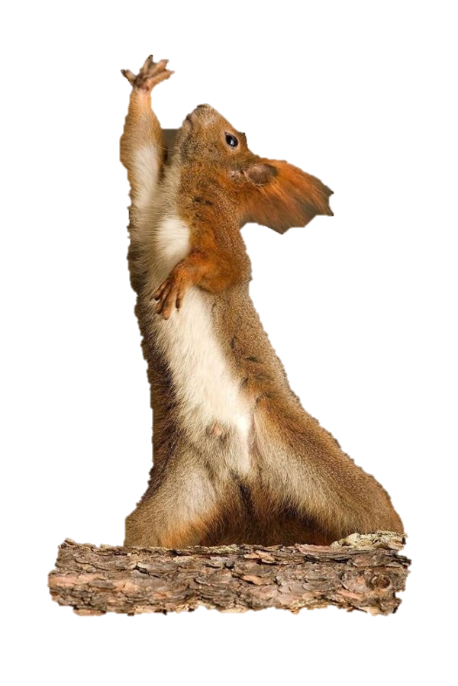
Emotions and Challenges
Tension and release
Fiero
Physical challenges
Twitch
Dexterity
Precision
Mental challenges
Prediction
Strategy
Memorisation
Coordination

Slide 5
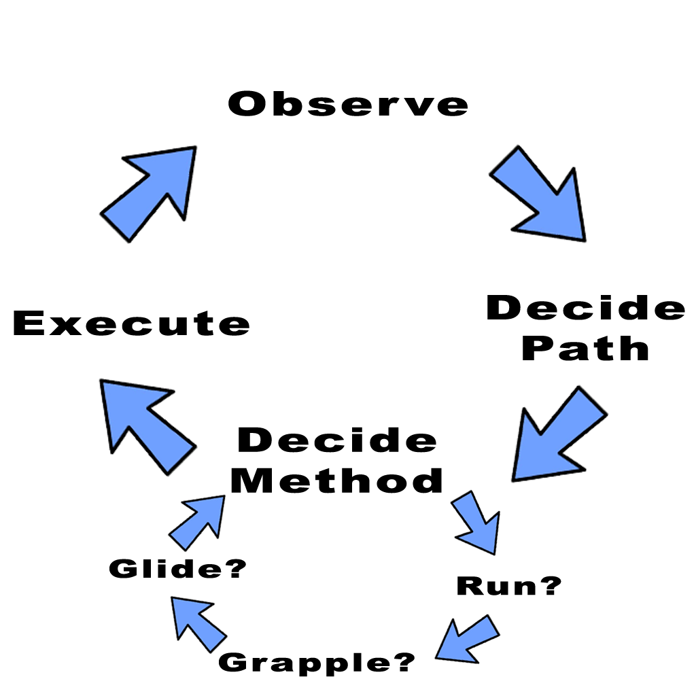
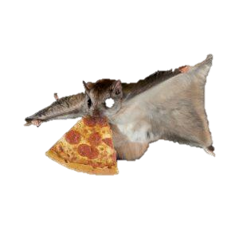
What did they do?
Overall goal:
Obtain 3 nuts before anyone else.
Descend the hill
Grab a nut
Return to base
Notes:
Core game loop:
Observe the level and potential paths through it.
Decide on the optimal path through the map.
Decide the method to achieve that route (ground movement/grapple/glide)
Execute.
Overall goal:
Obtain 3 nuts before anyone else.
Descend the hill
Grab a nut
Return to base

Slide 6
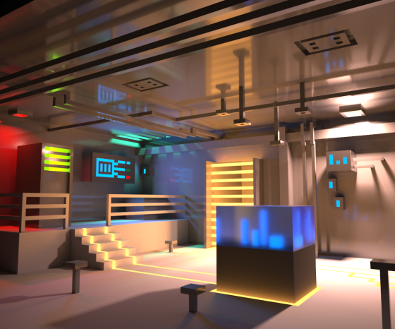
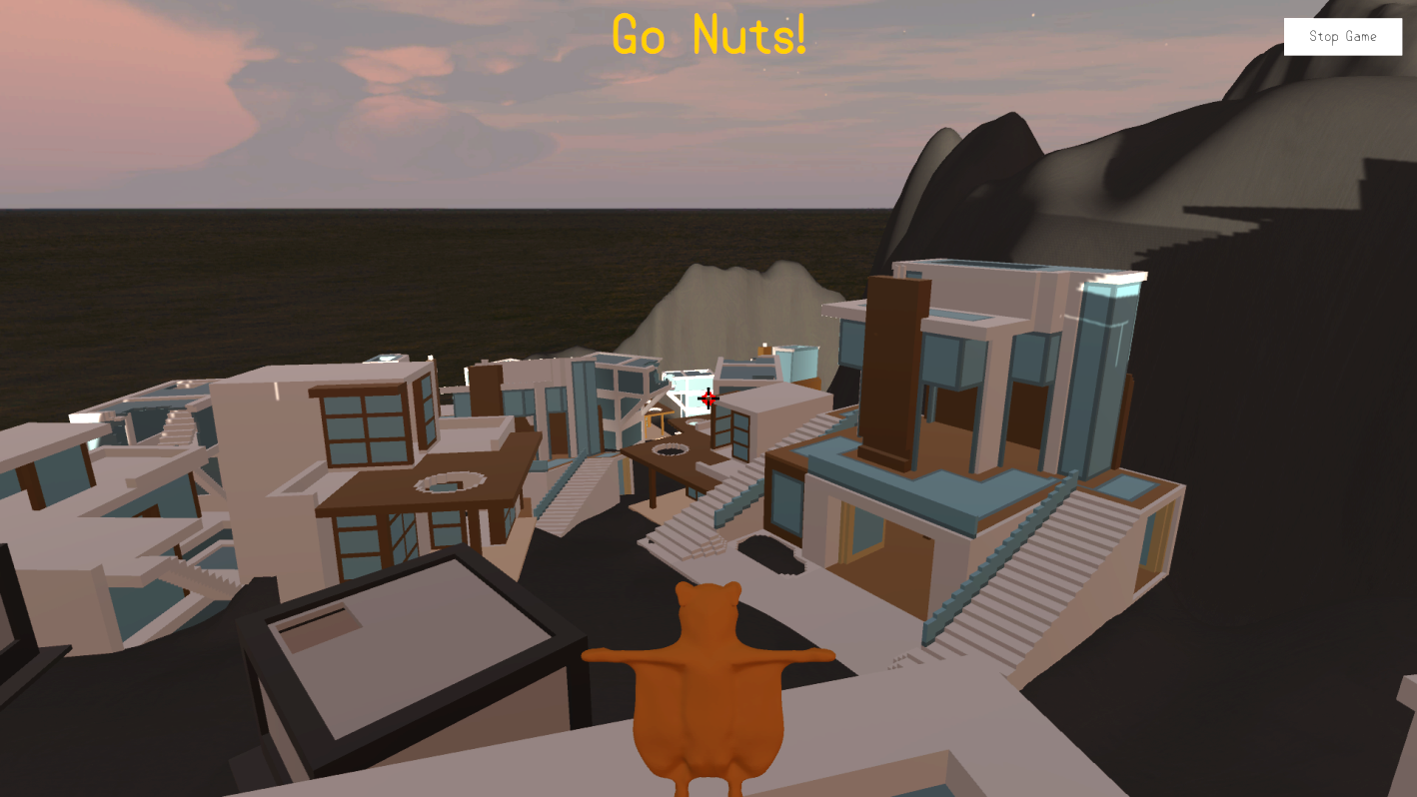


What did it look like?

Slide 7
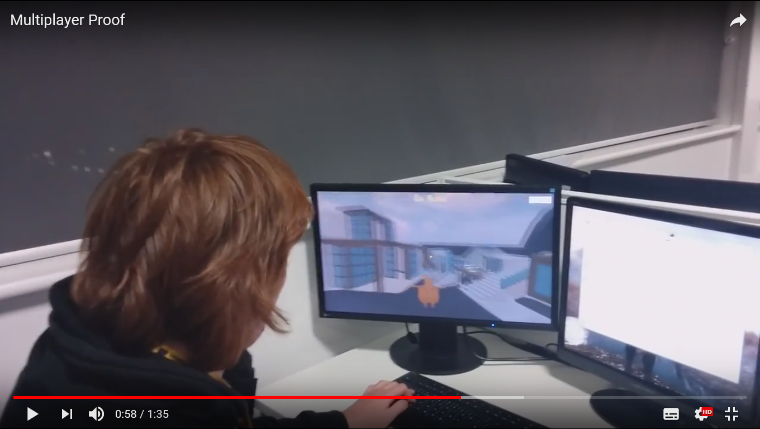
Gameplay & Feedback
Player Perspective
Multiplayer Gameplay
Enjoyed the multiplayer
The grapple was fun to use
“I had no idea where to go”
Hard to scale some buildings
Couldn’t see the grapple cooldown timer

Slide 8
Why are we changing it?
Glide rarely being used
Glide allowed players to ignore platforming
No sense of direction
Optimal routes
INSERT PICTURE HERE

Slide 9
What’s changed?
Removed glide mechanic
Adjusted the jump
Complete overhaul and redesign of the level
INSERT SCREENSHOT(S) OF CURRENT LEVEL HERE
Notes:
We removed the glide mechanic. Players were almost never using it – between the fact with no animations it’s almost impossible to tell if you’re using it, it not being bound to a typical button (E) and it rendering half the platforming in our level pointless, we decided it would be best to remove it at least for the time being.
Players said themselves that the grapple was where the fun was, so in removing the glide mechanic we’re also putting a bigger emphasis on the grapple.
In previous iterations the jump felt very floaty. With the glide in place this felt ok and thematically made sense, however without the glide it doesn’t make much sense. We’re iterating the physics surrounding the jump so it feels a bit more natural and responsive.

Slide 10
Gameplay
D E L E T E M E
INSERT CURRENT FOOTAGE IF RELEVANT
Notes:
We removed the glide mechanic. Players were almost never using it – between the fact with no animations it’s almost impossible to tell if you’re using it, it not being bound to a typical button (E) and it rendering half the platforming in our level pointless, we decided it would be best to remove it at least for the time being.
Players said themselves that the grapple was where the fun was, so in removing the glide mechanic we’re also putting a bigger emphasis on the grapple.
In previous iterations the jump felt very floaty. With the glide in place this felt ok and thematically made sense, however without the glide it doesn’t make much sense. We’re iterating the physics surrounding the jump so it feels a bit more natural and responsive.

Slide 11
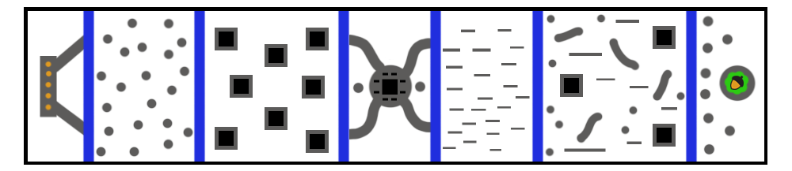
The Level
Start Jump Grapple Interaction Walljump All Tree
Teach the players the mechanics one at a time

Slide 12
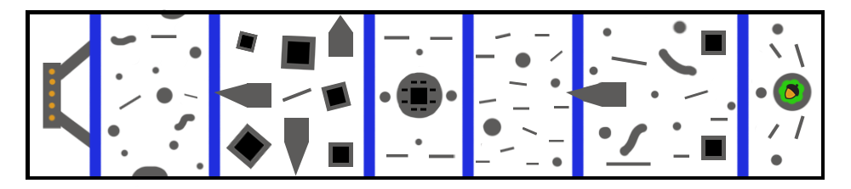
The Level – Stretch Goal
Level becomes dynamic
Moving platforms
Structure collapse
Scale of objects change

Slide 13
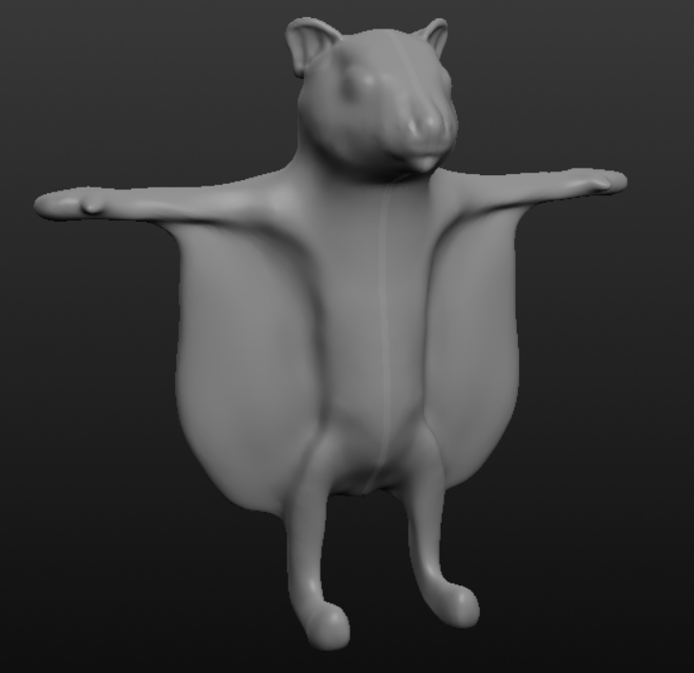
Going forward
Level design iterations
Lighting/layout/guidance
UI design and implementation
Player character model adjustment,
texturing and animations
Further playtesting
Notes:
Player model may get wings removed if we continue with no glide mechanic. If we remove flight it doesn’t need to be a flying squirrel.

Slide 14
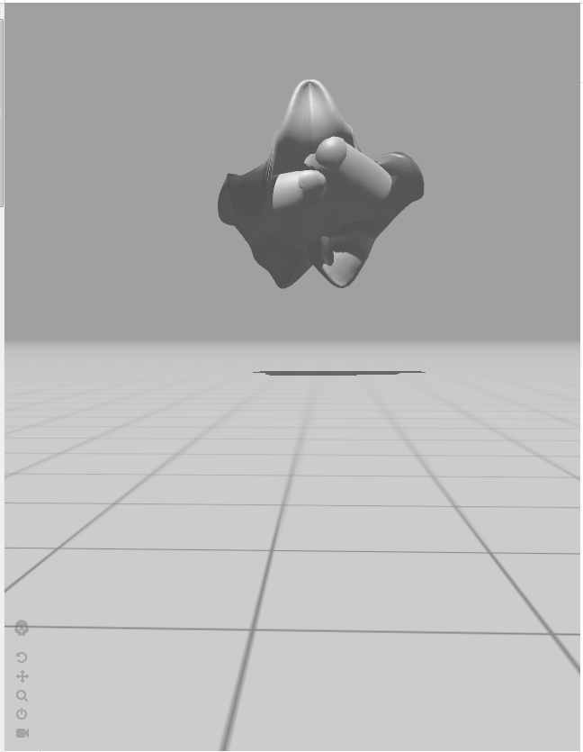
Questions?
Elliot Page – Max Carter – Zachari Cooper – Rebecca Brannum – Joe Wilson

